Slide 1
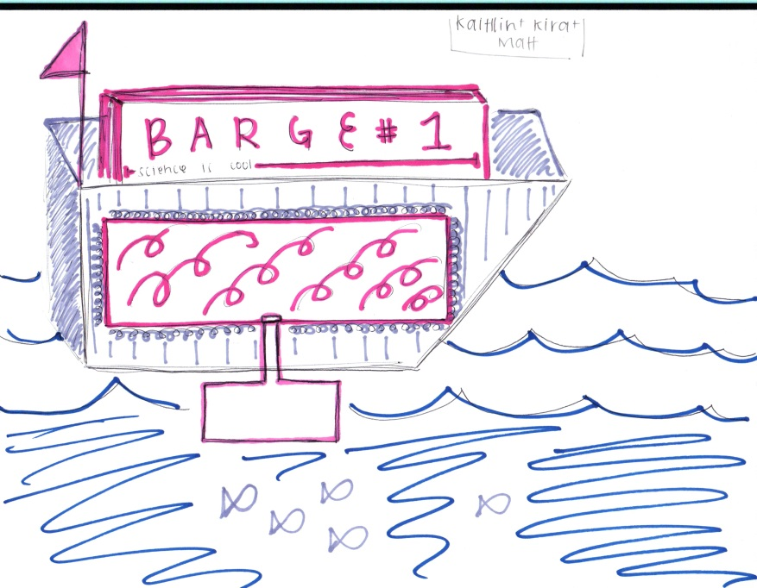
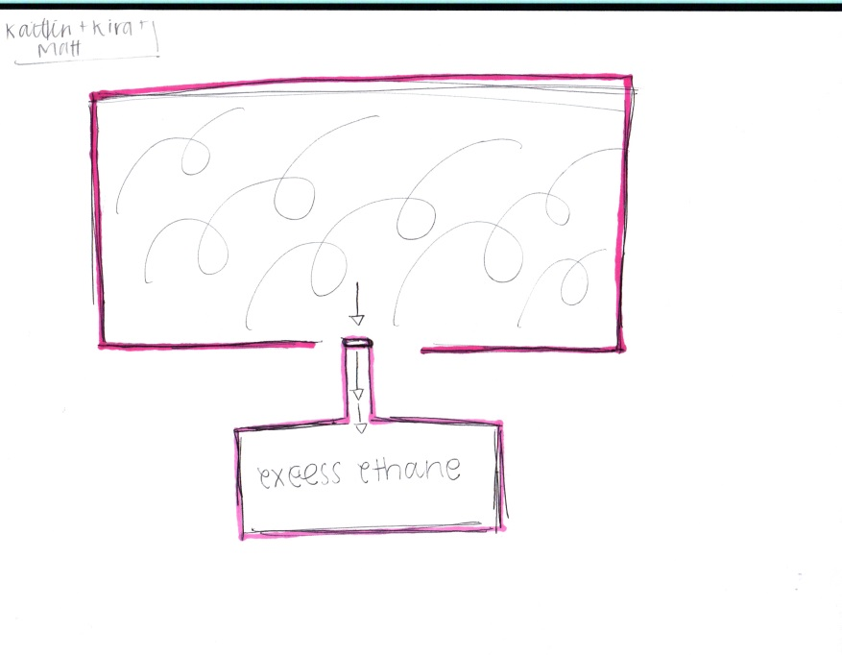
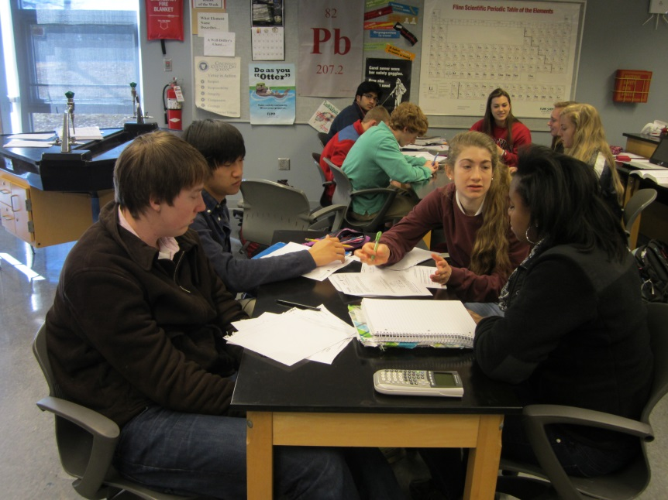
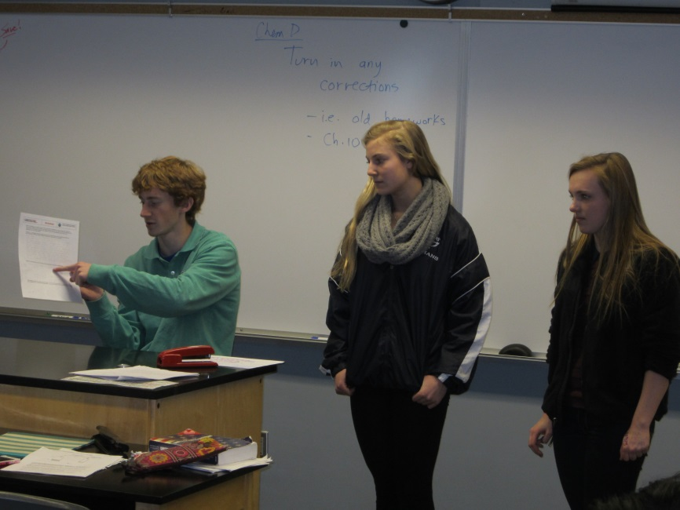
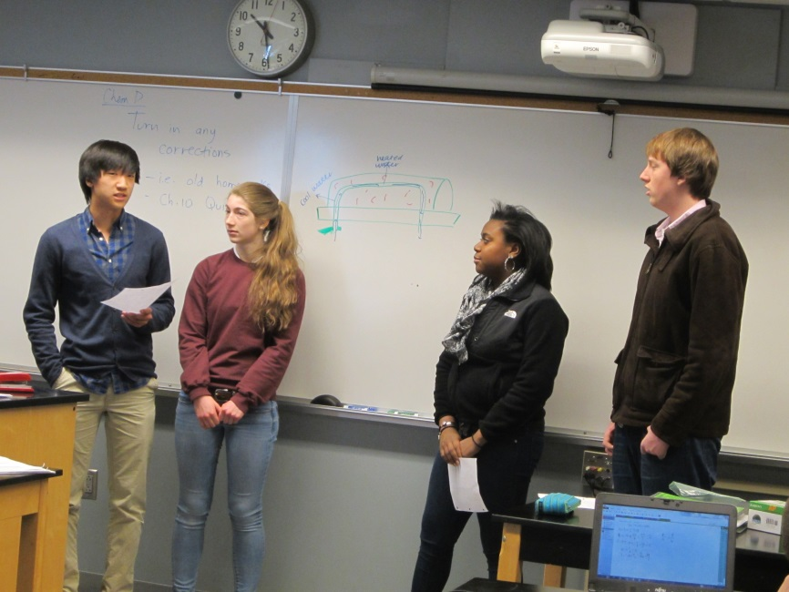
Pressure System Design Trent Amstutz Cincinnati Country Day School, High School Chemistry
RET is funded by the National Science Foundation, grant # EEC 0808696.
Unit Overview
Unit Activity Implementation
Student Work
Topic:
Individual gas laws and the ideal gas law.
Standards: NGSS
HSETS1-1,2,3 – Engineering Design
HS-PS1-7 – Chemical Reactions
HS-PS2-3 – Forces and Interactions
The activity was implemented over 3 days. The students on day one went through an overview of a real life scenario which required transporting a gas safely in a barge. They worked through a series of problems related to the scenario in groups. This setup a situation in which an explosion would take place and they needed to devise an engineering solution to prevent this. To arrive at their solutions, they were required to use the gas laws they had recently learned in class.
During the second two days they brainstormed solutions using gas laws and revised their work based on feedback I gave them. The final solutions they came up with were presented to the class along with supporting calculations and drawings to validate what they showed. Each group took questions demonstrating their level of comprehension with the topics and then answered a summative question which was evaluated.
“By lowering the gas’s temperature, fewer collisions of gas particles (lower KE) the pressure decreases”
“Our idea is to increase the volume to ensure that the pressure is not exceeded…The increased volume tank would be under the barge submerged in water. Therefore, it will chill the gas even further, allowing more space.”
There are no statistical points of reference that can be used to address the usefulness of this activity. No pre-assessment was implemented to properly assess the level of understanding the students had prior to the activity due to communication issues.
Qualitatively, the students prior to the activity were very hesitant and timid in solving problems with gas laws. During the presentations by the students, a clear mastery and comfort level was present that showed advanced understanding far beyond where they started. This level of mastery can be seen in the showcased work above. Students provided creative problem solutions utilizing their knowledge of gas laws including emergency contingency plans, spare volume, controlled release and cooling from river water.
Assessment Results:
Impact on Student Learning
Activity Structure
Title: Pressure System Design
Guiding Questions:
How can we safely transport industrial gases that pose serious environmental health and safety problems if released into the atmosphere?
How can we calculate changes to a gas system?
How can we construct a basic engineering solution to a problem?
How can we modify our solutions based on instructor feedback?
How can we communicate solutions to our peers?
Objectives:
Make basic calculations using the ideal gas law
Identify how gas laws affect a real industrial system
Creatively brainstorm basic engineering solutions to chemical problems
Design a solution to the selected challenge
Modify that solution from feedback provided by the instructor based on specific criteria
Present the solution to their peers providing justification for their chosen solutions
Engineering Design Process
Reflection and Conclusion
EDP: With this activity limited in its scope to a short timeframe, a full embrace of the engineering design process was not achievable. The groups individually on day two came up with designs which they presented to me. I presented feedback to guide their thinking and assist in reiteration in their work. Although they didn’t collect data on their own and act on the conclusions from that, a portion of the whole process was embraced through the feedback given to the students.
ACS: The activity was applied in its direct nature with the students creating solutions to a specific real life problem that exists on a tangible and concrete level. The activity related to careers through showing the students the types of problems that engineers actually work on. I showed them a chemical facility during the first day lecture and part of that talk involved exploring the types of careers that exist at those places. The activity also addressed societal impact by looking at a large problem that confronts anyone who transports gases. It looked at the tradeoffs that people who transport dangerous materials must address in the process of conducting their business.
The activity did a wonderful job of engaging students who typically feel that classroom work is abstract and irrelevant. It allowed many students to shine and it developed the critical thinking skills of all involved in a really immeasurable way. The direct ties between classroom material and a real life problem helped inspire may students. One student quote was “An interesting background made the activity feel more like a real world solution instead of just a math and chemistry problem.”
I do also have some ideas for how to improve the activity. The structure for feedback to the students could be improved to take advantage of more principles in the engineering design process. This would help promote ownership within the groups. Also, the activity could be revised to a full challenge activity where the students devise the guiding questions. This would also help with student ownership of the project.

